Slide 1


Symfony, PHP and its Foundation
<?
https://externals.io/message/118040
Nicolas Grekas
@nicolasgrekas

Slide 2
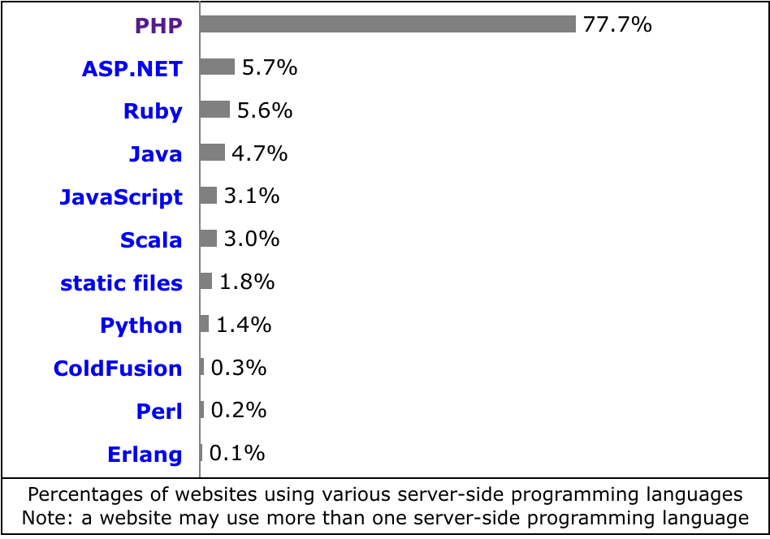
PHP leads the web

Slide 3
PHP leads the web
Apple
Facebook
Pfizer
Flipkart
Slack
Spotify
Etsy
etc. etc. etc.

Slide 4
How many contributors
were paid to work on
the PHP engine in 2021?

Slide 5

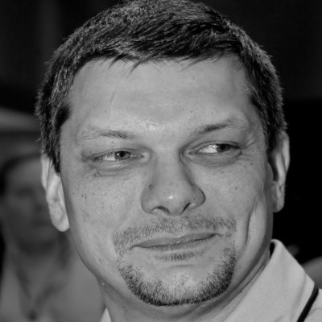

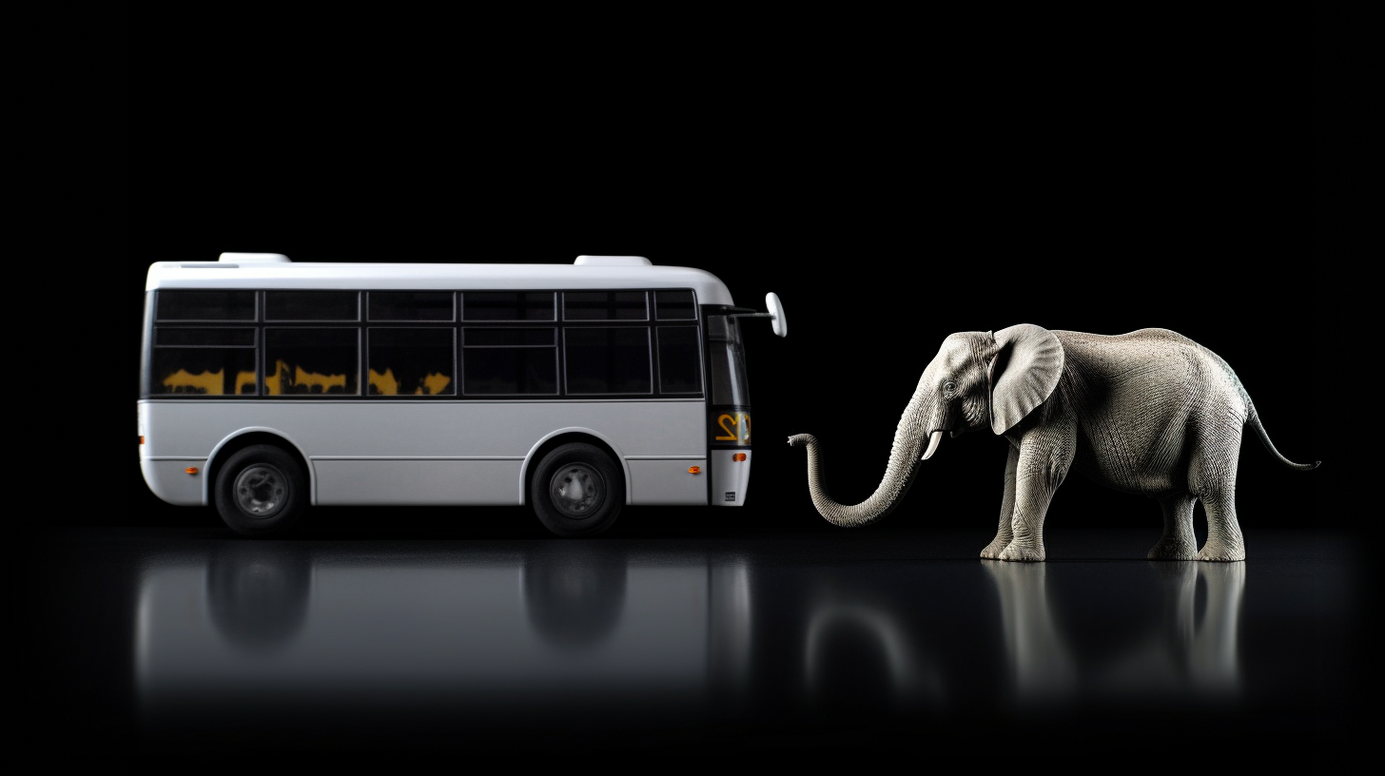
PHP’s Bus Factor
Dmitry Stogov
Nikita Popov

Slide 6
Surviving buses
May 4, 2021: Blog post by Joe Watkins
May 20, 2021: JetBrains reaches out to Joe
Nov. 22, 2021: Nikita announces he leaves JetBrains

Slide 7
JetBrains
Does it make sense to look for a replacement
and pay for just one developer again?

Slide 8
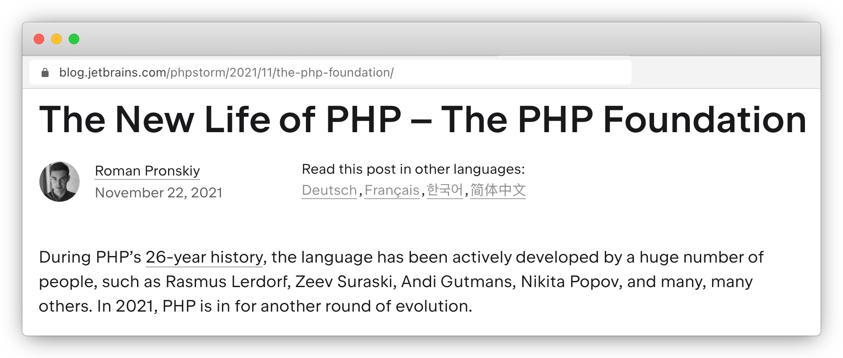

Slide 9
Founding companies
Acquia
Automattic
Craft CMS
JetBrains
Laravel
PrestaShop
Private Packagist
Symfony
Tideways
Zend by Perforce

Slide 10

We support, advance,
and develop
the PHP language

Slide 11
“The PHP Foundation's mission is to ensure the long-term prosperity of the PHP language.”
Improve the language for its users
Provide high-quality maintenance
Retain current contributors and welcome new ones
Promote the public image of PHP
php.foundation

Slide 12
“The language decisions are the matter of internals@lists.php.net”
php.foundation

Slide 13
Funding PHP

Slide 14
Funding PHP
Total raised: | $ 1,111k
From organizations: | 80%
From individuals: | 20%

Slide 15
Funding PHP
Total raised: | $ 1,111k
Recurring: | 50%
One time: | 50%

Slide 16

Funding PHP: Companies

Slide 17
Spending the funds

Slide 18
Spending the funds
Total raised: | $ 1,111k
Paid developers: | $ 408k
Balance: | $ 703k

Slide 19
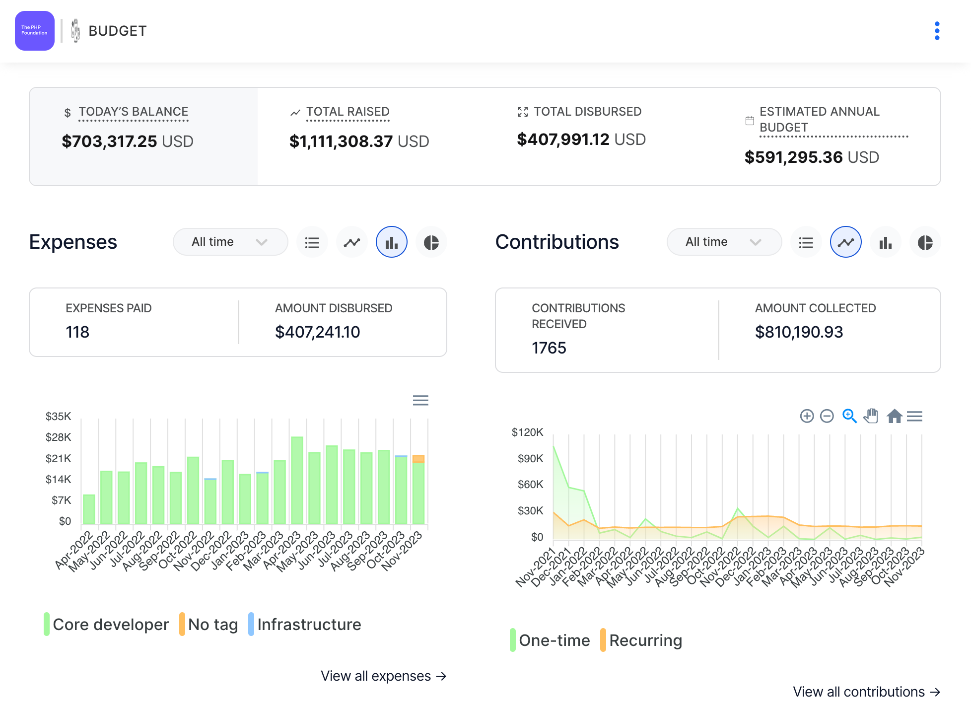
Budget is public
https://opencollective.com/phpfoundation#category-BUDGET

Slide 20
The team

Slide 21
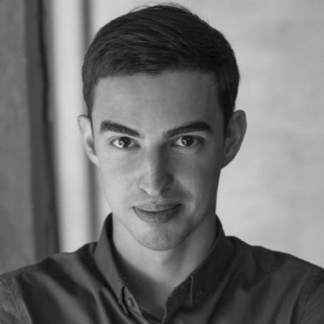






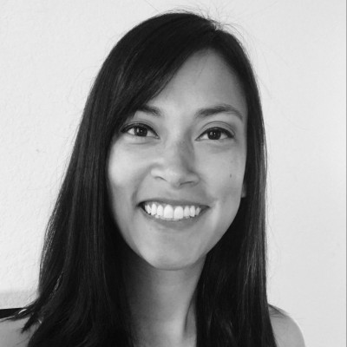
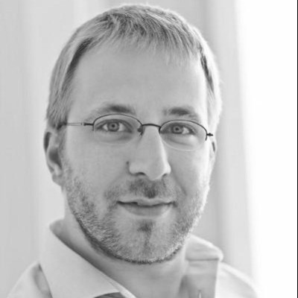



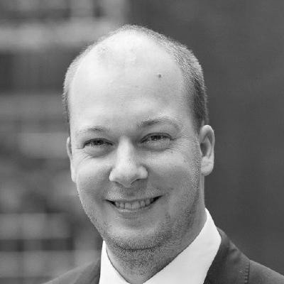






Team
Developers
Board
Community

Slide 22
Team
Paid by the Foundation
Paid by JetBrains
Paid by Zend
Developers
Board
Community

Slide 23
Language Impact
The PHP Foundation
Other
contributors
Share of commits in PHP repository

Slide 24
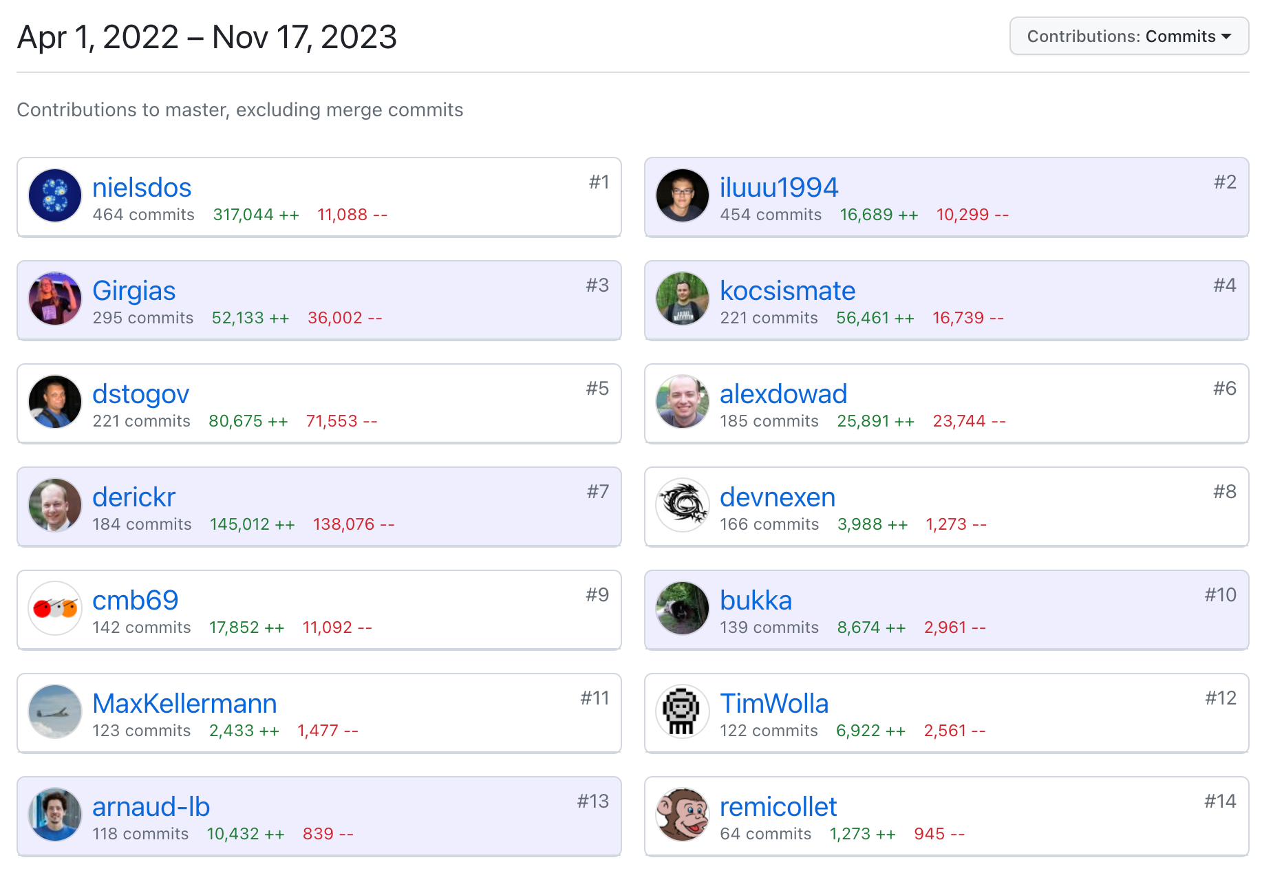
Language Impact

Slide 25
What are the devs working on?
(Fancy things only)

Slide 26

New autoloading mechanism 🚧
Gina Peter Banyard

Slide 27
Property hooks 🚧
Ilija Tovilo

Slide 28
class User
{
public function __construct(
private string $first,
private string $last,
) {
}
public string $fullName {
get => $this->first . ' ' . $this->last;
set($v) => [$this->first, $this->last] = explode(' ', $v);
}
}

Slide 29
Lazy objects 🚧
Generics 🚧
Arnaud Le Blanc

Slide 30
$obj = (new ReflectionClass($class))->newInstanceWithoutConstructor();
$r = ReflectionLazyObject::makeLazy($obj, function (object $obj) {
$args = // compute arguments on demand
$obj->__construct(...$args);
});
$r->skipProperty($propertyName);
// ...
ReflectionLazyObject::isLazyObject($obj);
$r = ReflectionLazyObject::fromInstance($obj);
$r->initialize();

Slide 31

Potential on symfony/var-exporter

Slide 32


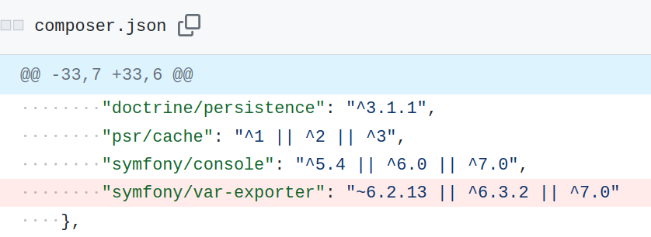
Potential on doctrine/orm

Slide 33
Clone with 🚧
Máté Kocsis

Slide 34
class Response
{
public readonly int $status;
public function withStatus($status): static
{
return clone $this with [
'status' => $status,
];
}
}

Slide 35
PECL overhaul 🚧
Derick Rethans

Slide 36
JSONSchema support 🚧
Jakub Zelenka

Slide 37
Future goals
Hire and mentor more core devs
More financial stability
Shape a roadmap

Slide 38
Projects 2024
PECL Overhaul
Security Audit
FPM Stability
Documentation

Slide 39



Advisory Board

Slide 40
Get bugs fixed
Cannot hydrate a DateTime instance created without the constructor #8152
Casting an object to array does not unwrap references #8655
WeakMap prevents garbage collection #10043
Use zval storage for php://memory stream #11106
Allow suspending fibers in destructors #11389
Missing CURL_HTTP_VERSION_3 constant #11755
Wrong magic methods sequence with ?? operator #12695

Slide 41
Improve things
Make class_alias() work with internal classes #9826
Wrong closure scope class reported for static methods #8932
Add support for CURLOPT_QUICK_EXIT #10454
Allow writing to readonly properties during cloning #9403
Add ReflectionFunction::isAnonymous() #8499
Add Stringable interface #5083

Slide 42
Be a Backward Compatibility champion
Keep things working

Slide 43
How can you help?
Spread the word 🙏
php.foundation

Slide 44
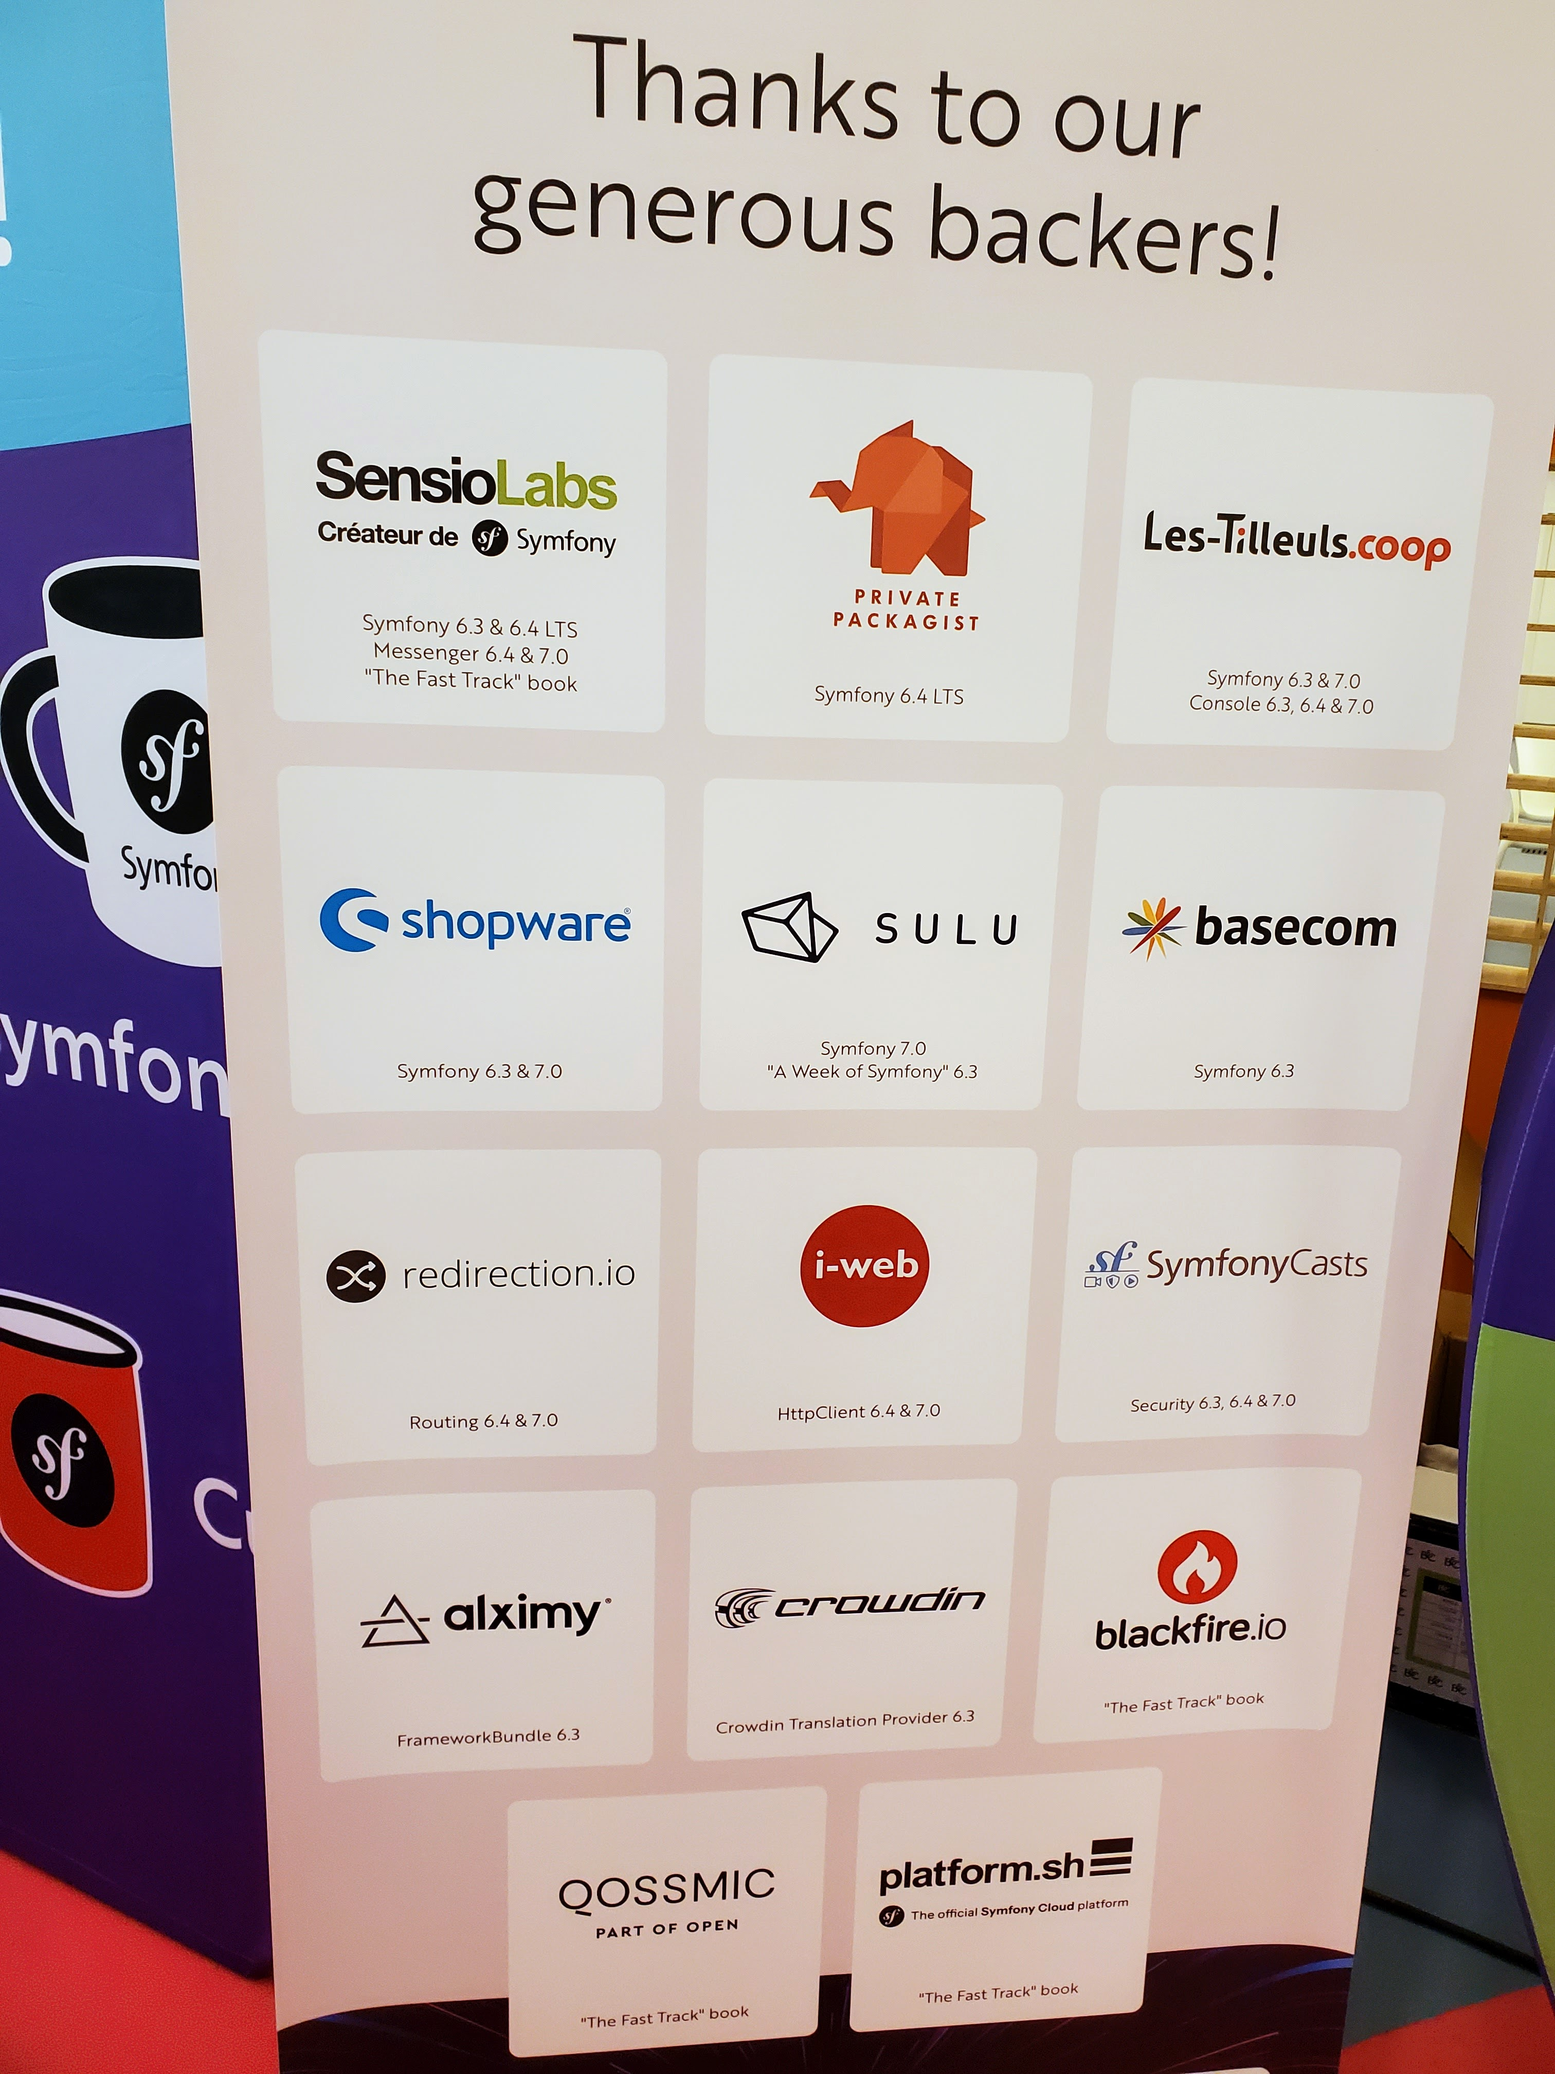
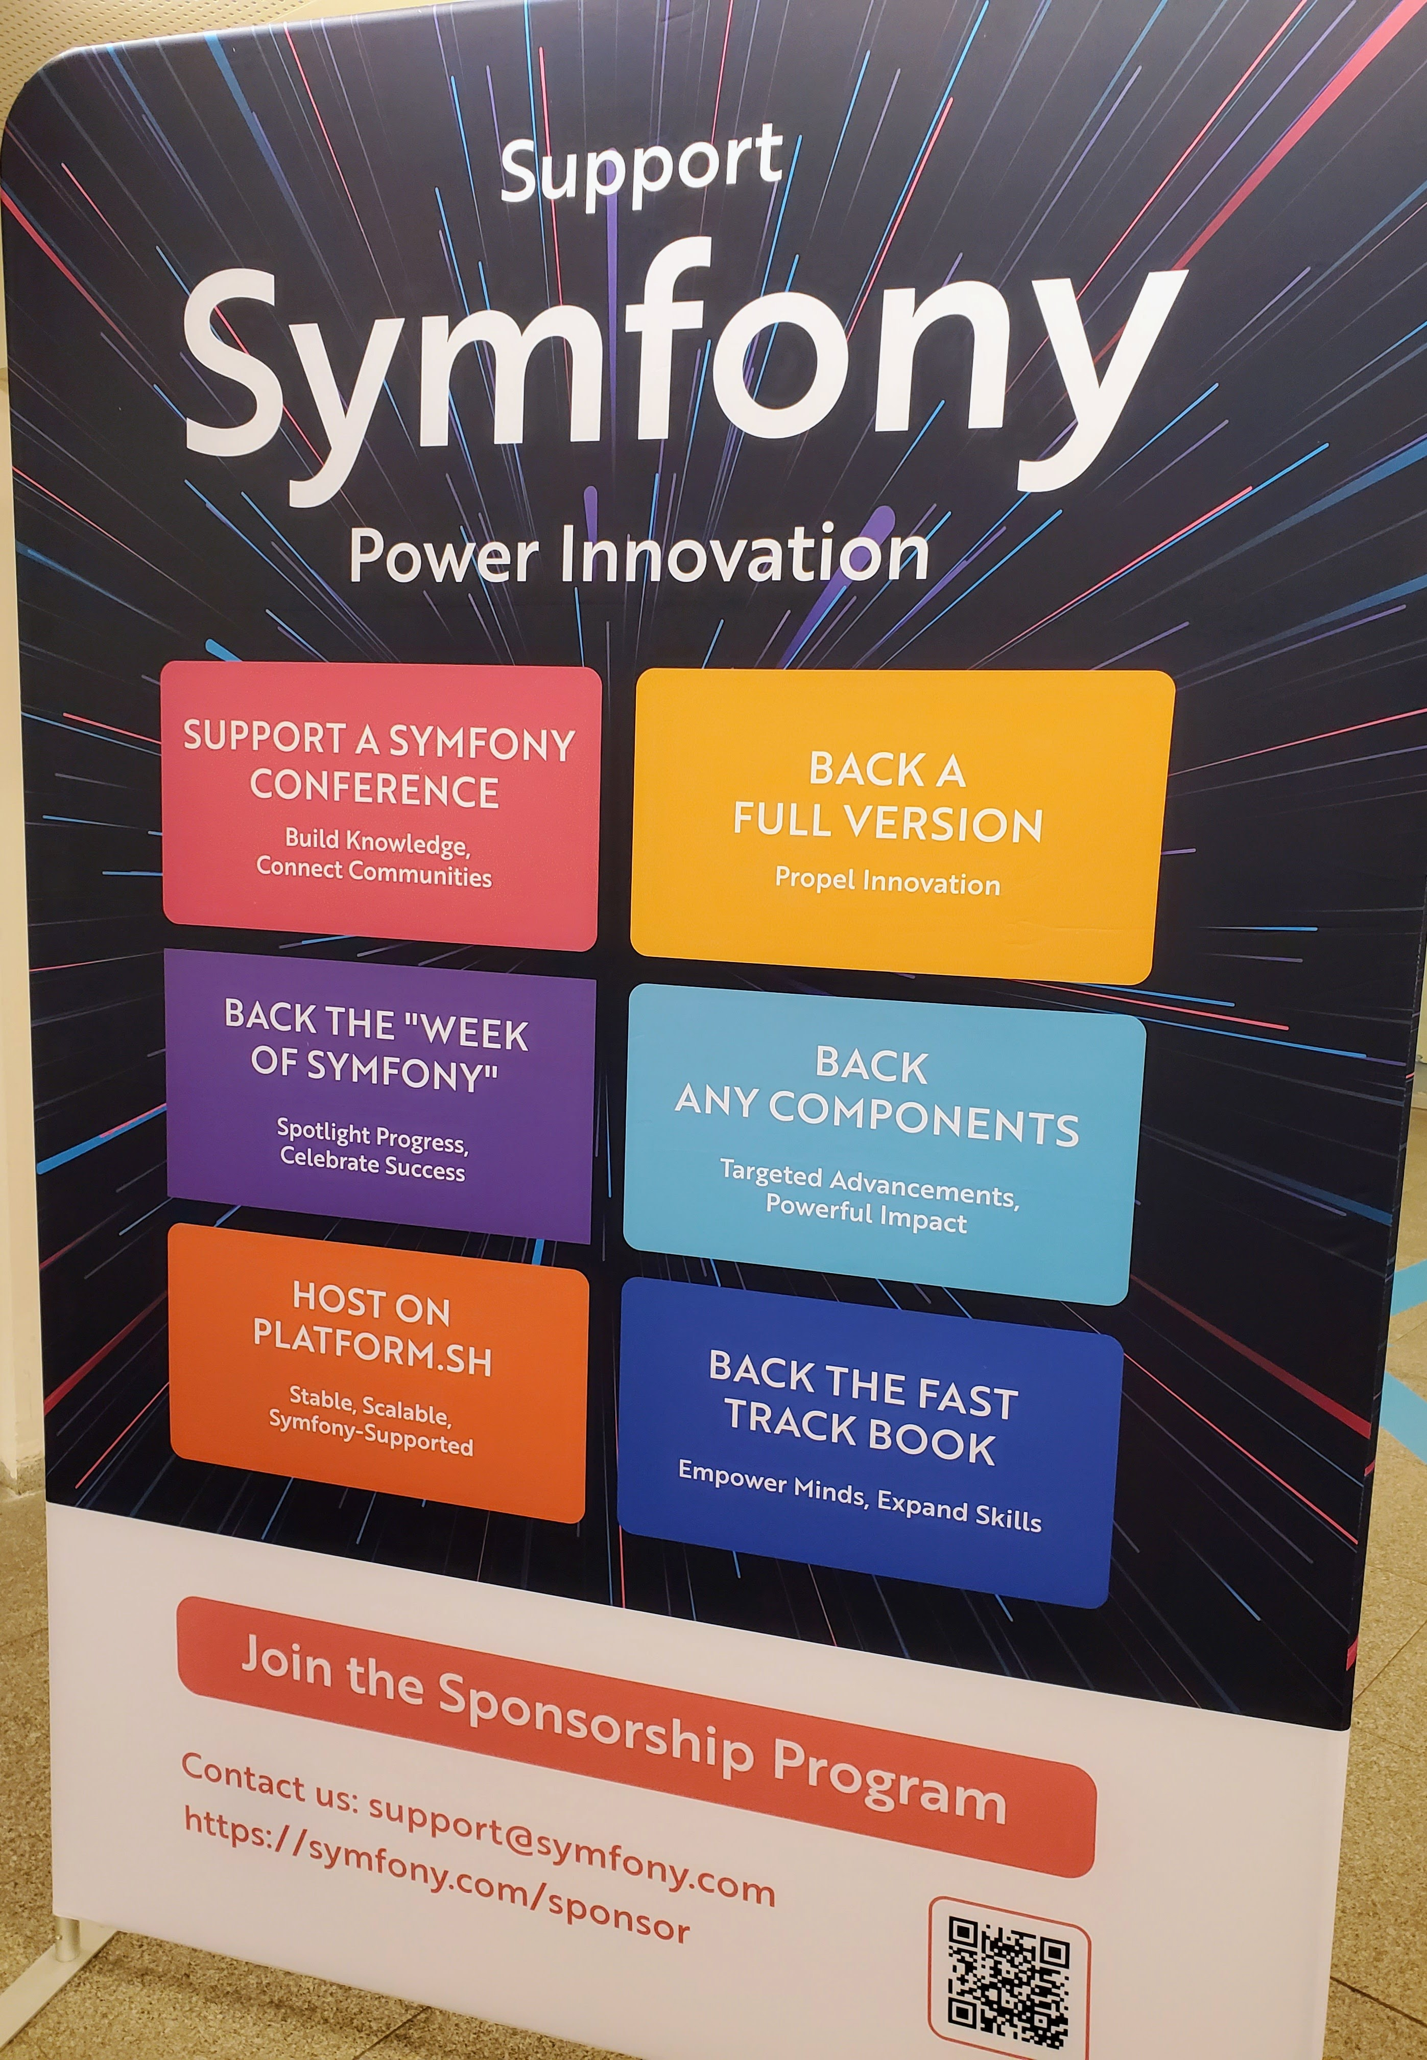

Slide 45
Thank you
<?
Nicolas Grekas
@nicolasgrekas

Slide 46
Thank you
<?
Nicolas Grekas
@nicolasgrekas

